Slide 1
Publishing Archival Photographs Concerns, Pittfalls and their technical implications
Publishing Archival Photographs: concerns, pittfalls and their technical implications
Publishing Archival Photographs: concerns, pittfalls and their technical implications
“Publishing Archival Photographs: concerns, pittfalls and their technical implications”
October 2015 – Brussels, JPEG

Slide 2
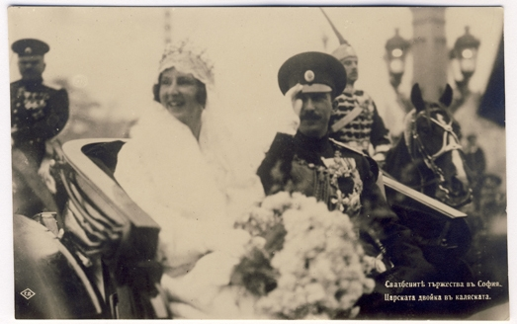
EuropeanaPhotography
1 February 2012 – 31 January 2015
Over 450,000 early photographs
selection, digitization, enrichment, ingestion to Europeana
Boris III of Bulgaria and Giovanna of Italy – the celebration of the royal wedding in Sofia.
© NALIS (Bulgaria)

Slide 3
19 partners - 13 EU countries, 3 associate partners
Coordinator: KU Leuven Technical Coordinator: Promoter srl
Associate partners:
Cyprus University of Technology
SC Bali Kiev
The Israeli Museum in Jerusalem

Slide 4
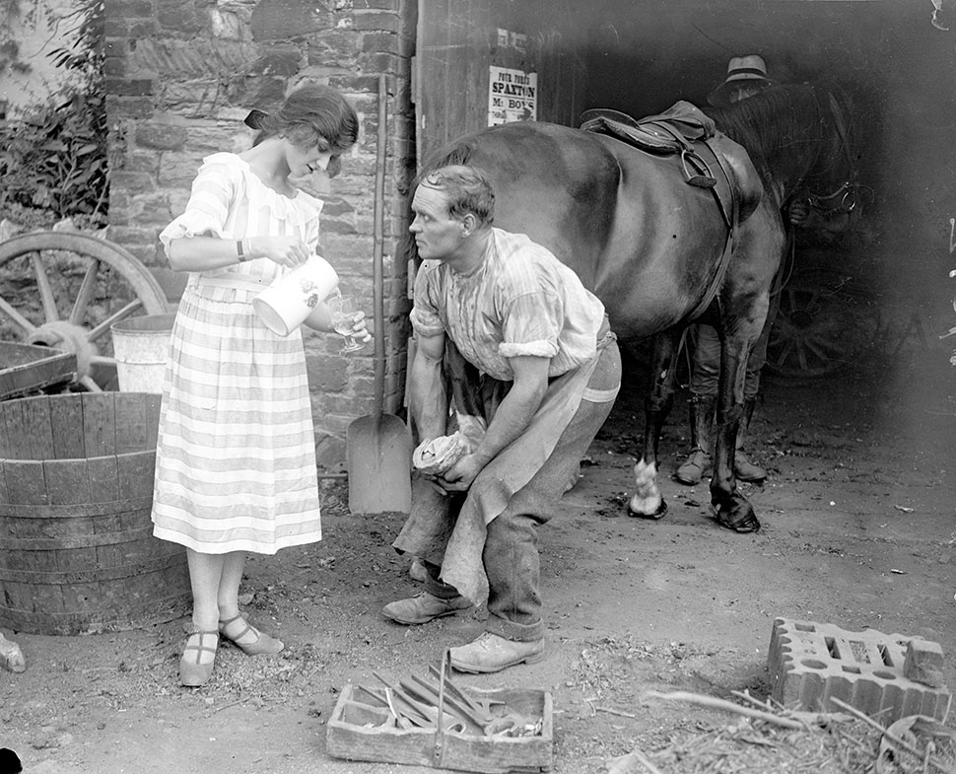
Alfieri | Bridgewater – Somerset (England), undated
Gelatin dry plate
Miss Edna Maude, a 17 year old dancer on holiday, offering the blacksmith a drink.

Slide 5
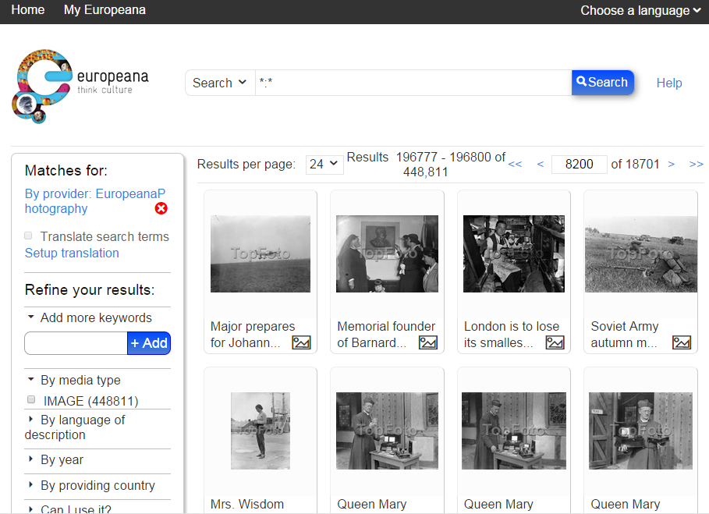

Slide 6
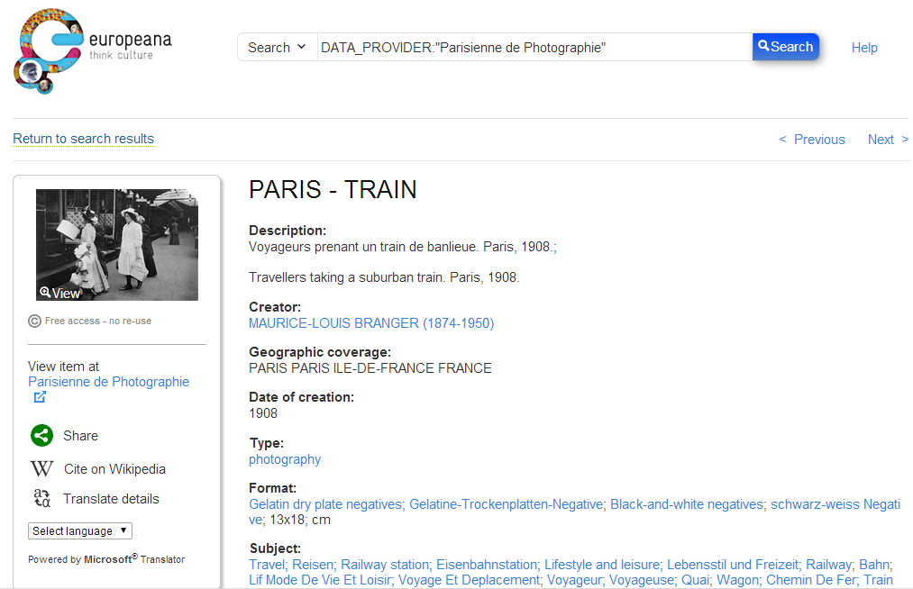

Slide 7
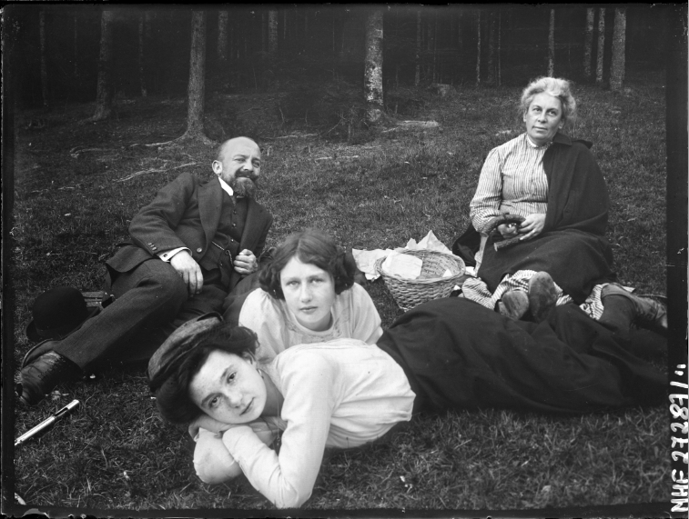
Klementyna Zubrzycka-Bączkowska | Raszówki (Poland), ca. 1910
Silver gelatin print
Picnic in the forest: a favorite pastime of the Polish gentry at the break of the 20th century. Franciszka Zubrzycka is enjoying a day out with her daughters and the local notary.

Slide 8
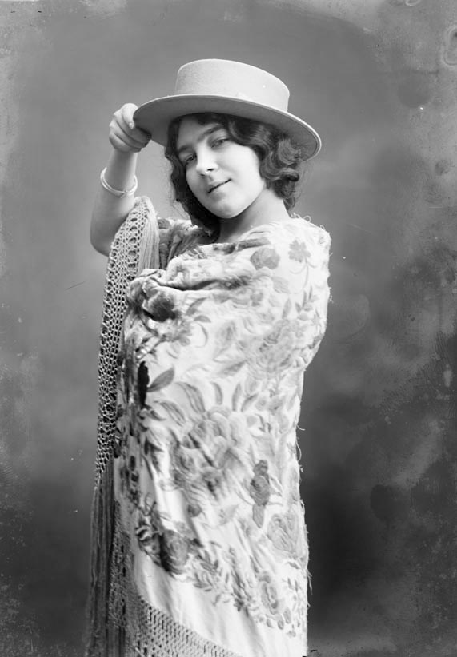
Courtesy of GenCat Cultura
Portrait of the actress Míriam, dressed with Manila shawl and Cordovan hat.
Author: Antonio Esplugas
Collection: Antonio Esplugas
Owner: National Archive of Catalonia (ANC).

Slide 9
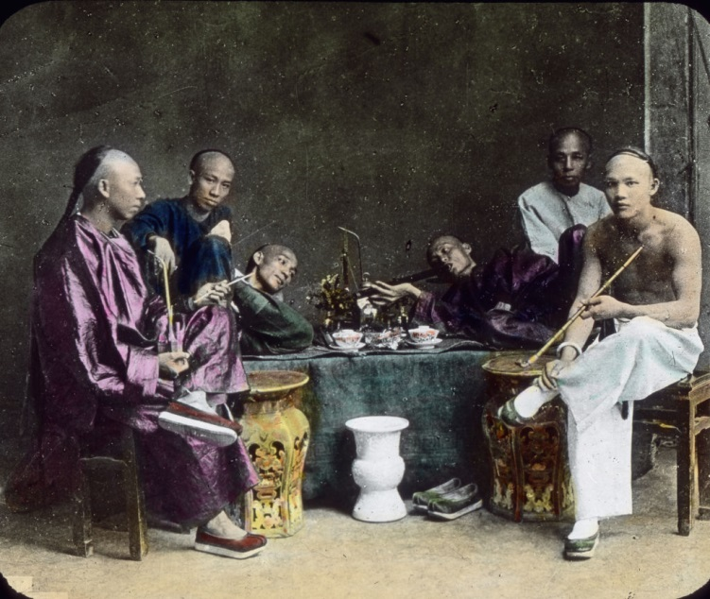
Chinese men smoking in Opium room.
© United Archives (Germany)

Slide 10
What will we discuss?
Experience of the project EuropeanaPhotography
Identified Problem areas
Analog to Digital
Privacy and Ethics
IPR

Slide 11
OUTCOMES OF THE PROJECT
451,178 digitized images accessible through Europeana currently
Digitization and metadata best practices
Multilingual vocabulary in 16 languages
EP-MINT mapping tool
IPR Guidebook
6. ‘All Our Yesterdays’ exhibitions
7. PHOTOCONSORTIUM established

Slide 12
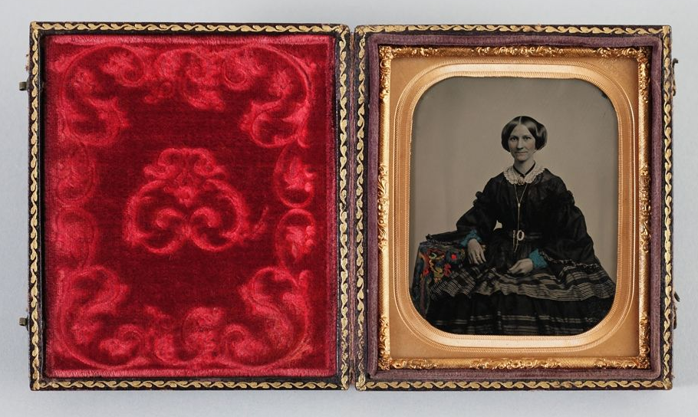
Techniques
Unknown woman. © M. K. Čiurlionis National Art Museum (Lithuania)
Daguerreotype
Tintype – Ambrotype
Wet collodion
Albumen print
Gelatin dry plate
Silver gelatin print
Autochrome
Nitrate film

Slide 13
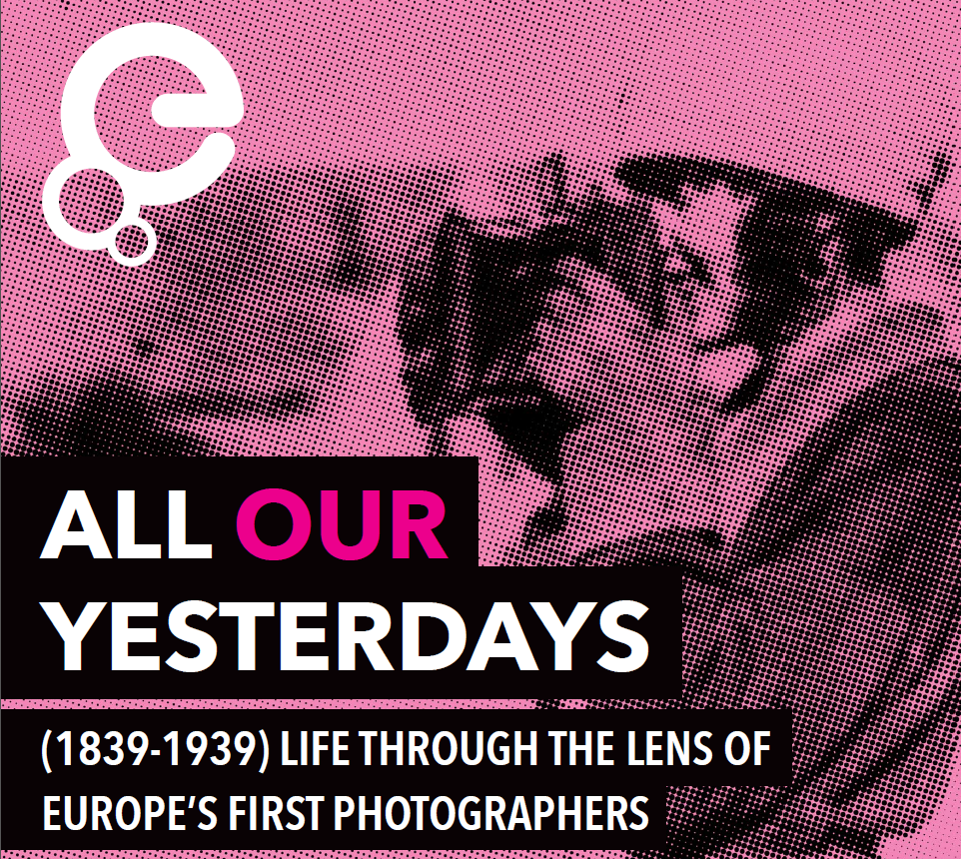

Slide 14
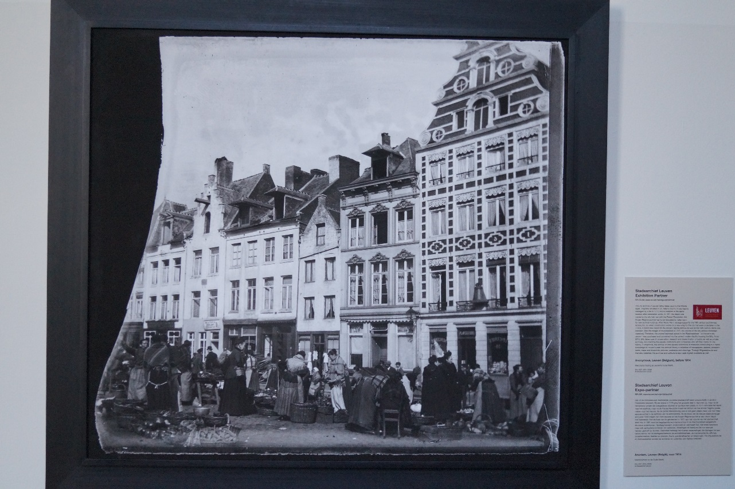
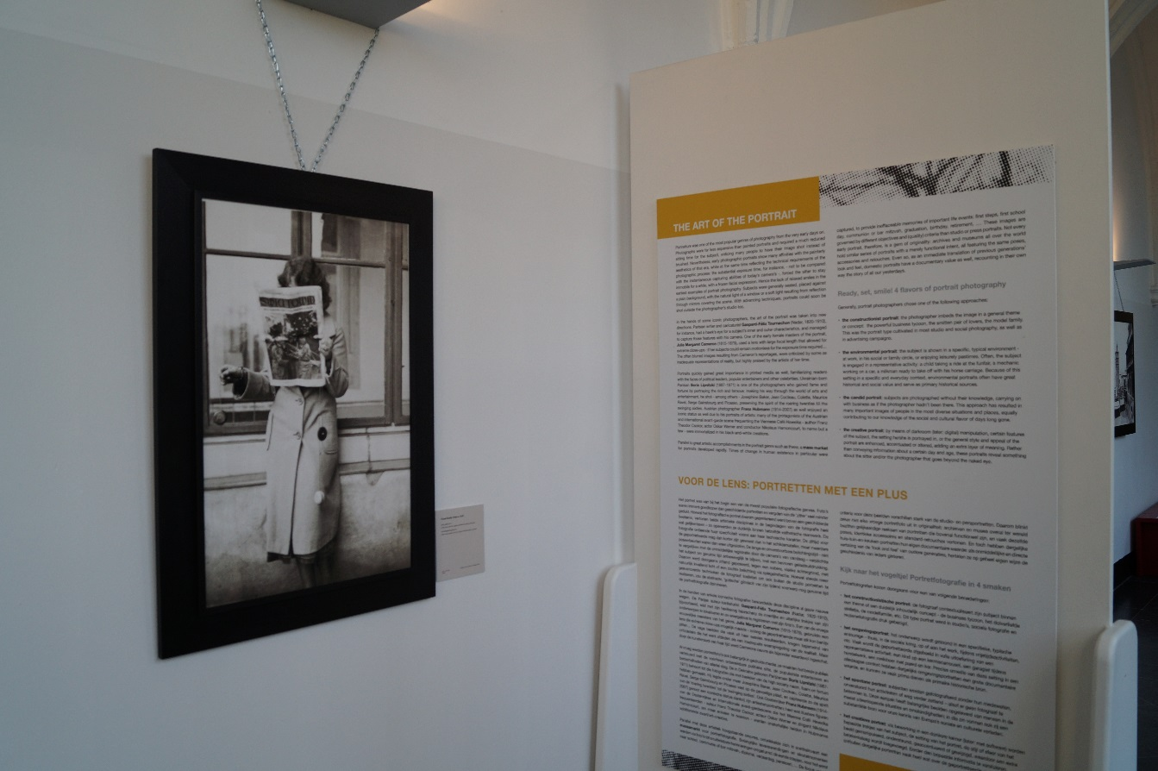
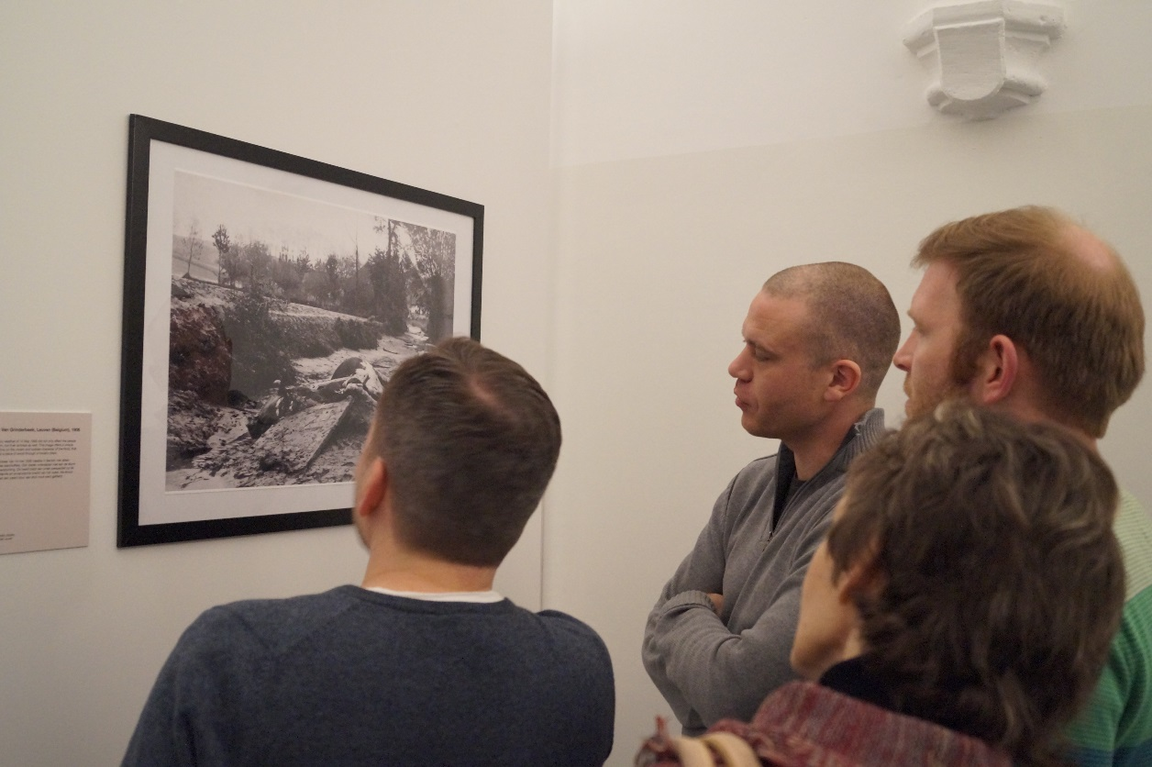
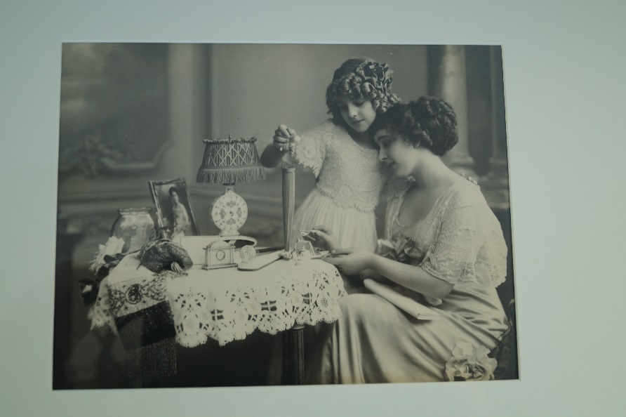

Slide 15
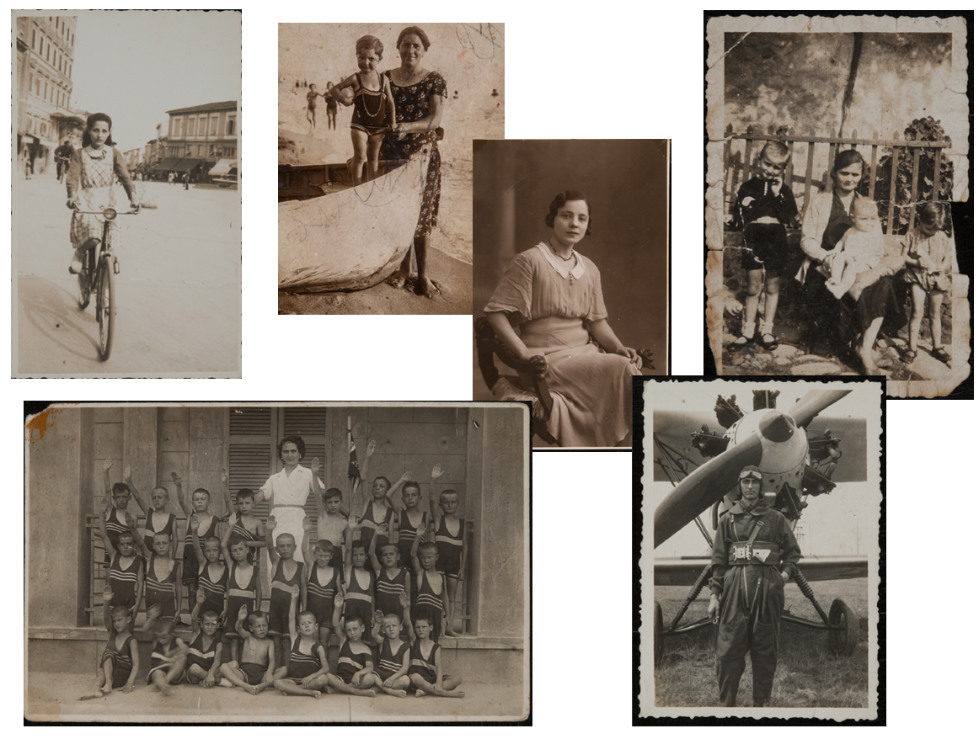
Photos contributed by visitors

Slide 16
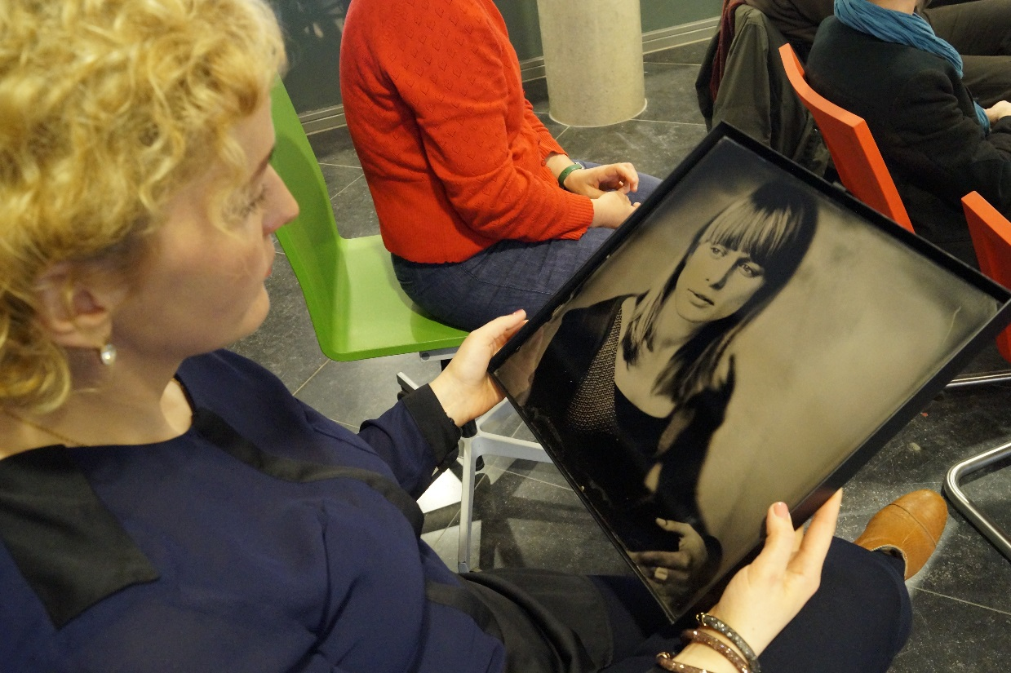

Slide 17
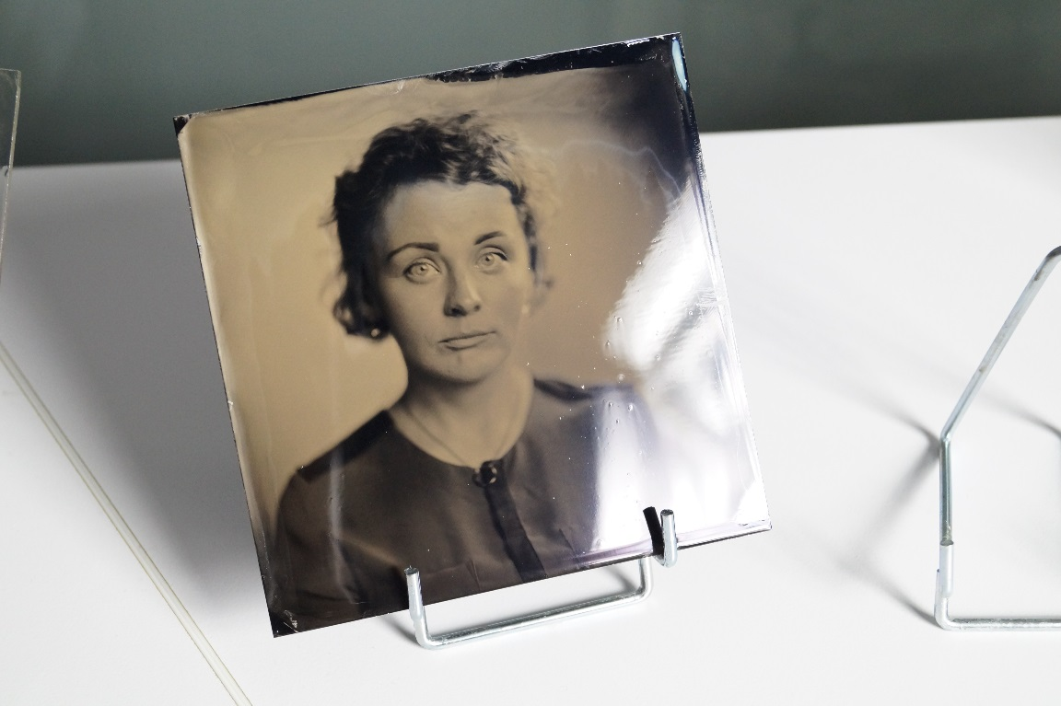
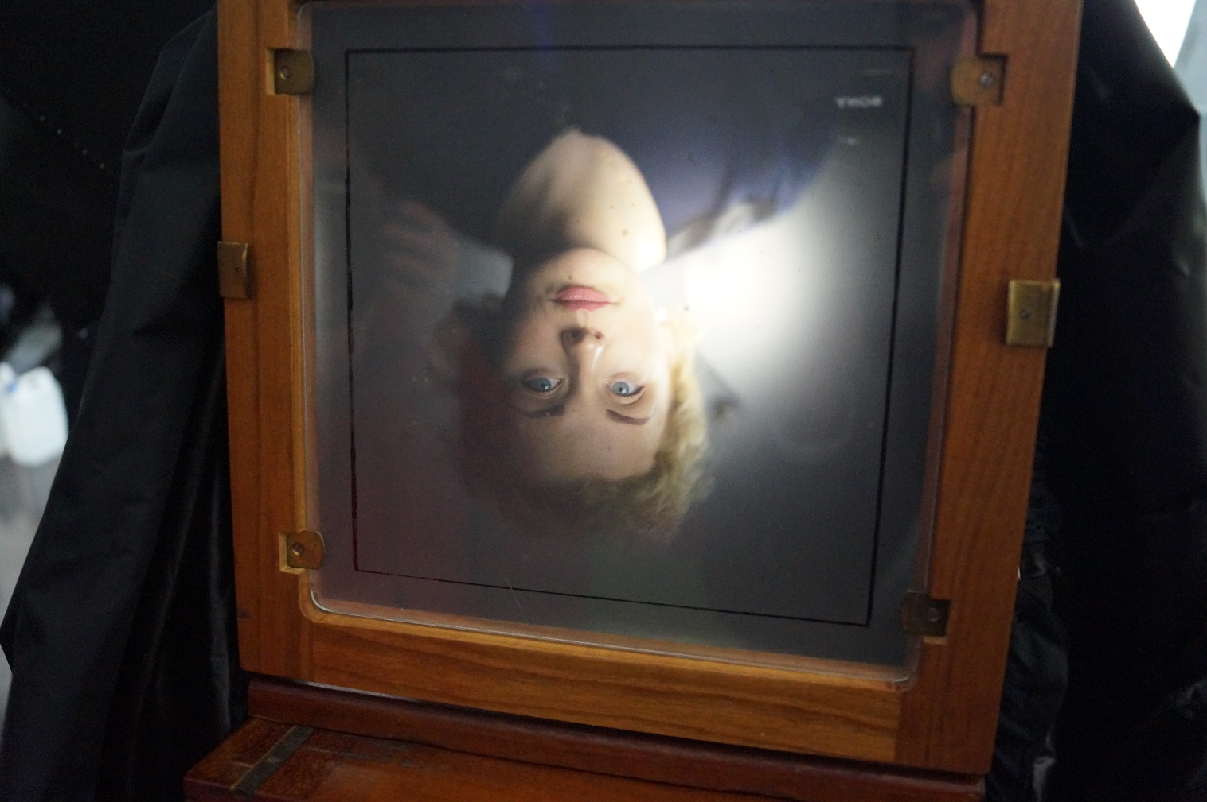
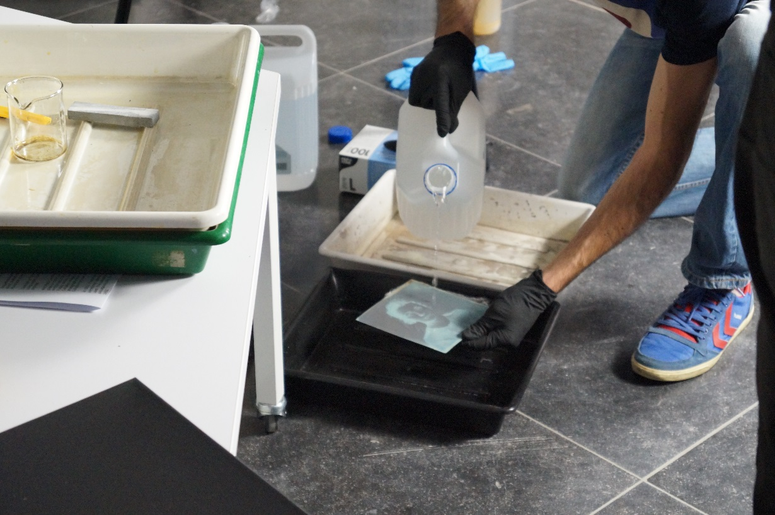

Slide 18
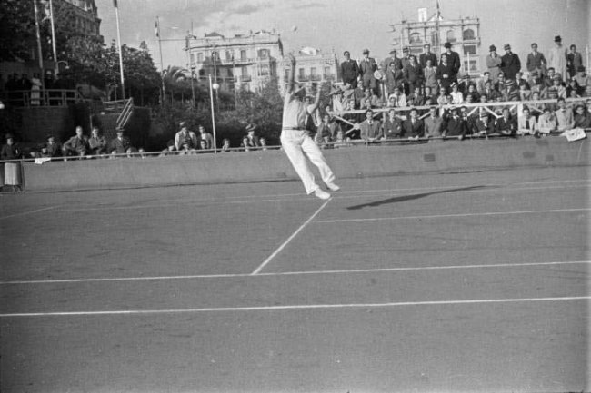
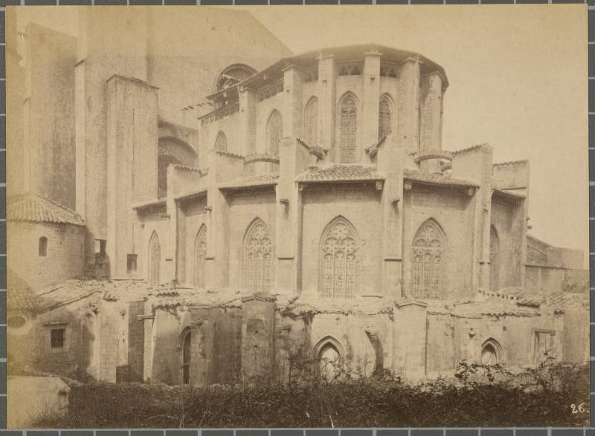
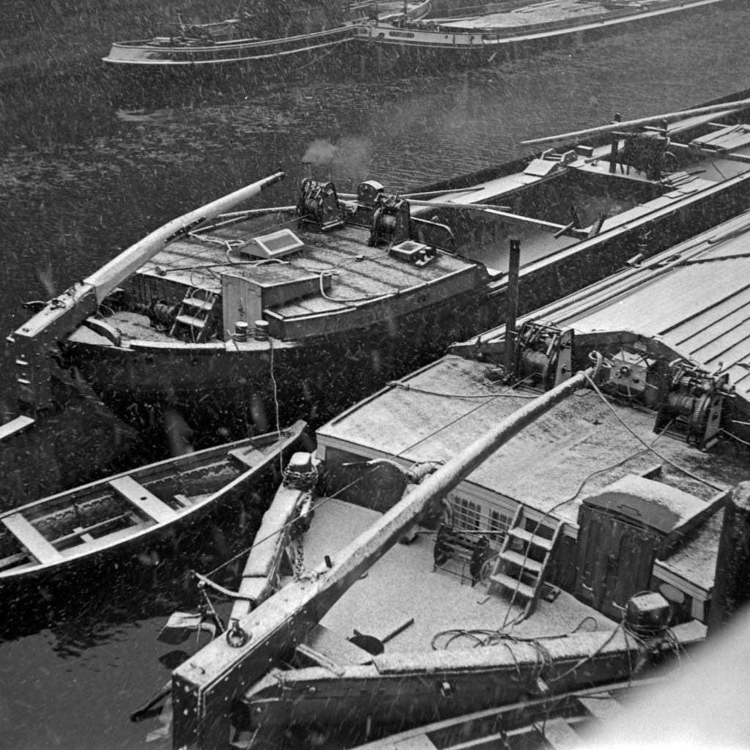
Data?
Davis Cup tennis Spain vs Germany – Josep Maria Sagarra i Plana, 26/04/1936 – Arxiu Nacional de Catalunya via Generalitat de Catalunya
CC BY-NC-ND
Absis of the Girona Cathedral – author unknown, 1880 – Ajuntament de Girona
Public Domain
Red Cross station at the station of Aubervilliers – Maurice-Louis Branger/Louis Viollet, 1914 – Parisienne de Photographie
Free access , no re-use
Barges on the river Spree – author unknown, 1930s – United Archives
Free access, no re-use
Notes:
So, in this talk, I’d like to show you some of the practicalities, the ways our project managed to get all these photos online, opened up to new audiences.
Now, while it would be fun to travel around Europe with a massive photoalbum with the over 450.000 photos showcased in Europeana Photography, it’s not very practical. So, we digitise them, and created metadata for each one of them.
For the digitisation process, we tried to capture the best practice in factsheets, available on our website.

Slide 19
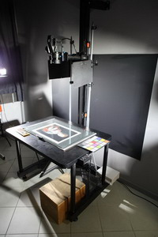
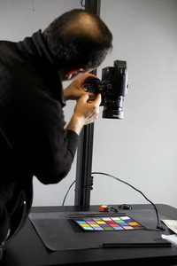
DIGITISATION
DIGITIZATION AND METADATA BEST PRACTICES
GUIDELINES > DIGITIZATION
Capture according to EP specifications
Device conformance testing and calibration, based on established benchmarks and specifications
Digital conversion
Image processing: correction/editing/processing to digital files
File naming
File formats and compression for archiving and preservation

Slide 20
GUIDELINES > PRE-INGESTION QUALITY CHECK
Standards and guidelines are a first guarantee for image quality
After digitizing, images are tested on
correct file naming
size of images
acceptable borders and margins
images completeness
correct graphic files
image characteristics (resolution, bit-depth, colour space, etc.)

Slide 21
GUIDELINES > POST-INGESTION QUALITY CHECK
Metadata Task Force tests content uploaded on MINT for the following criteria
Quality of the Metadata
Findability in multiple languages
Quality of the Digitization
Quality and Resolution of the Preview

Slide 22
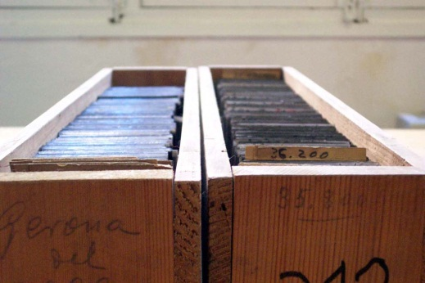
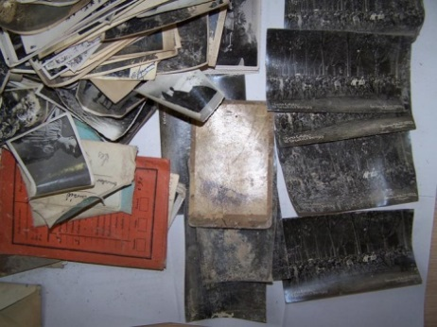
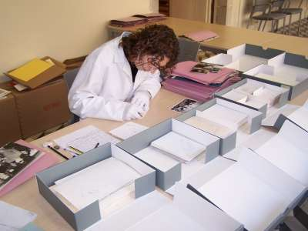
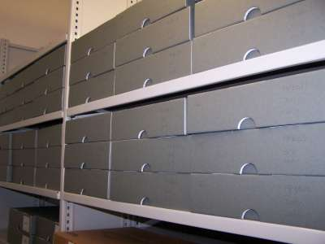
Archival preparation of originals
Analysis
Physical and intellectual organization
Preservation preparation of originals
Evaluation of physical condition
Cleaning
Restoration

Slide 23
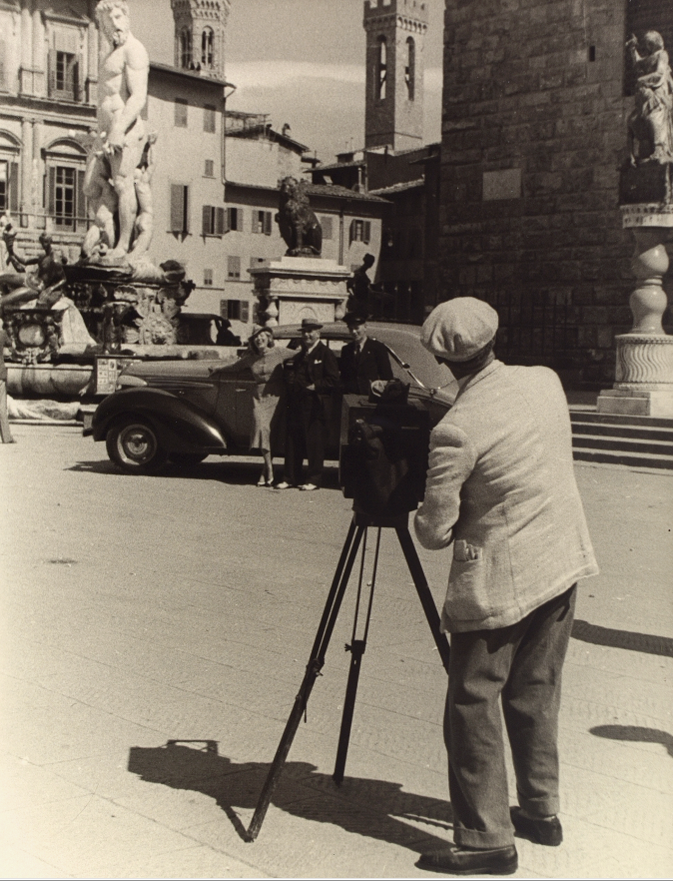
The digital object
Image, Negative, Photo, Document,
… Representation
Retouching, Restoring what?
Edmond Couchot, Image puissance Image 1984
Vincenzo Balocchi | Firenze (Italy), 1938
Silver gelatin print
Photographer at work at the Piazza della Signoria.

Slide 24
From Image to Photo
Photographic experience
Negative
/ CCD
Positive
Print copy
Captured light
Digital master
Digital copy
Reprint
Photographic Object
information
information

Slide 25
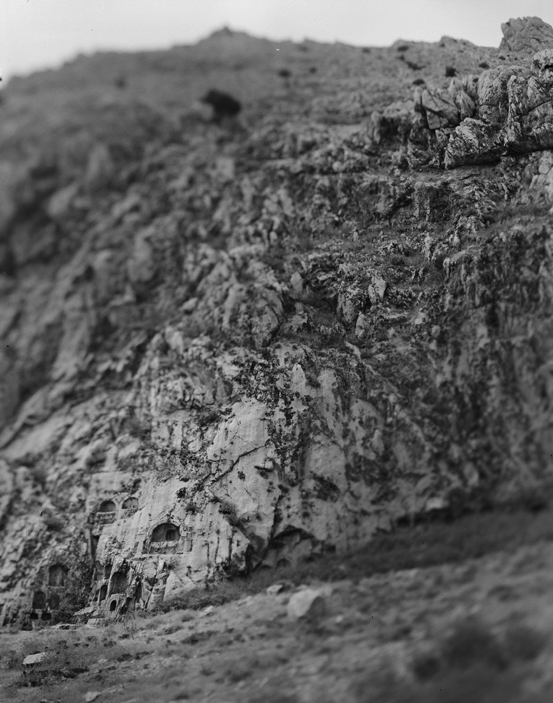
Incremental information
enhanced

Slide 26
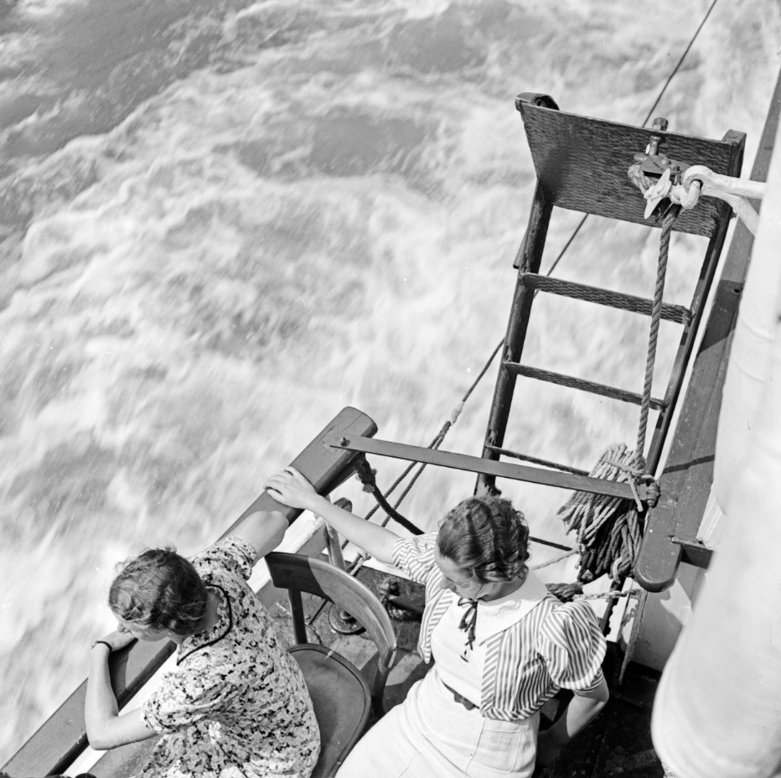
Digital Reframing
Detachment from original bearer
Decontextualisation Recontextualisation
Remediation
The photo as information vs. its materiality
Karl Heinrich Lämmel | Koblenz (Germany), 1930s
With the Köln Düsseldorfer white fleet on the river Rhine near Koblenz.

Slide 27
John Topham | Swanscombe (United Kingdom), 1938 - Gelatin dry plate - Lovers Lane, Swanscombe.

Slide 28
Rights labels
Europeana’s Rights Labels are inspired by Creative Commons Licenses
Public Domain Mark
Creative Commons CC-BY licenses

Slide 29
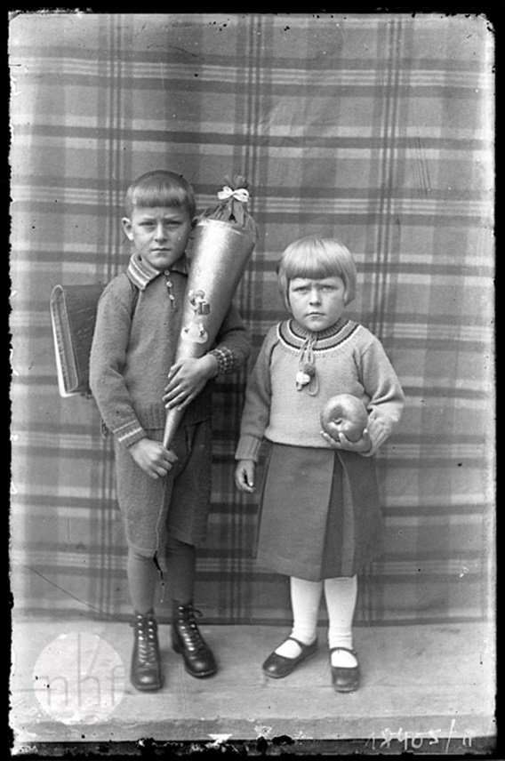
Tools: IPR GUIDEBOOK
The IPR Guidebook sheds light on the Europeana IPR model, the Data Exchange Agreement, and lists online supporting tools for companies and institutions:
Online guidebook:
http://europeana-photography.iprguide.org
IPR blog:
http://ep-blog.iprguide.org
Courtesy of MHF

Slide 30
IPR overview
Label | #in Europeana
Rights Reserved – Free Access | 127682
Rights Reserved – Paid Access | 117993
Public Domain Marked | 90490
CC-BY-NC-ND | 85067
Unknown | 16107
CC-BY-NC | 1221
TOTAL | 438560

Slide 31
IPR
Issues
Each internet use involves a copy
Is the digital master a new work or a technical copy?
Public domain is moving target
Need for OOC-NC label
Are labels rights claims? By whom?
No real fair use, unclear educational context
Orphan Works directive insufficient

Slide 32
Privacy and ethics
Issues
Not everything in an archival collection can be published
The meaning changes over time, also the sensitivities
Privacy of people depicted
Performative effects of publishing

Slide 33
Technical implications
Analog to Digital
Need for multispectral information, e.g. RGB + 2 IR + 1 UV
Definition of Master object
IPR
More refined rights metadata included in popular image standards
Ethics
Better protection of image integrity by digital fingerprinting

Slide 34
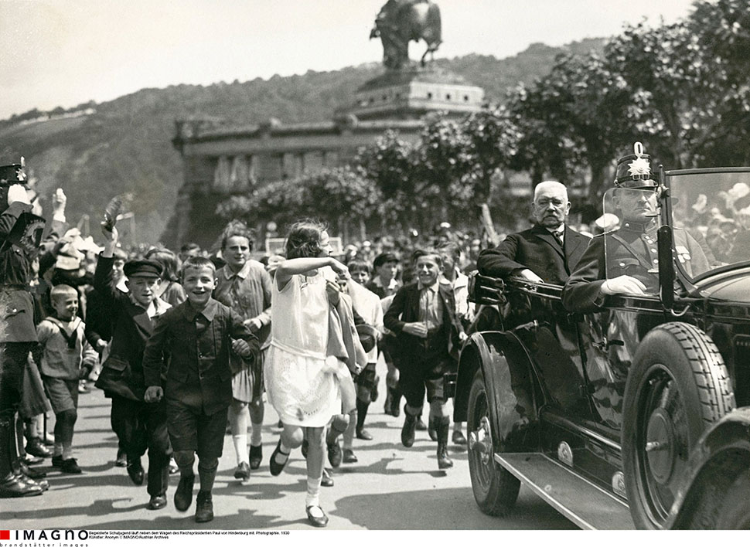
Paul van Hinderburg enters Koblenz 1930

Slide 35
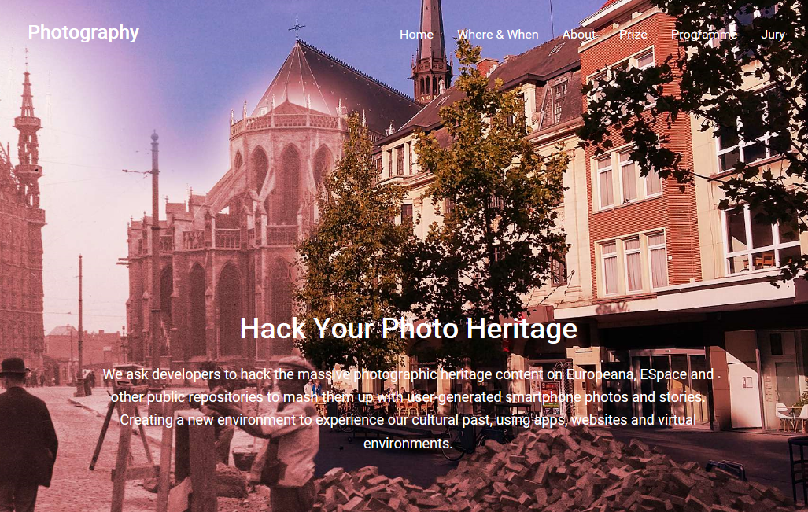

Slide 36
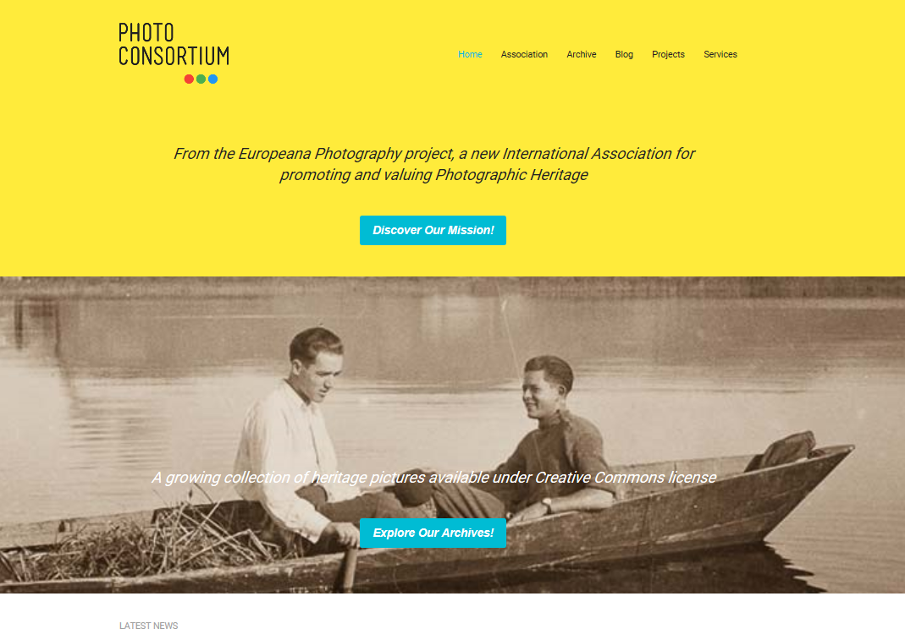
contact
www.photoconsortium.net
info@photoconsortium.net

